Slide 1
Breast Cancer
Microarray Gene Expression datasets
dataSet link :
https://www.kaggle.com/datasets/raghadalharbi/breast-cancer-gene-expression-profiles-metabric

Slide 2
Team members:
Reem Osama Abdel Moneim
Habeba Allah Adnan Ahmed
Muhammad Ehab Muhammad Khalil
Mohamed Medhat Abdelrady
Amr Mohamed Gaber.

Slide 3
Introduction
Breast cancer is the most frequent cancer among women, impacting 2.1 million women each year. Breast cancer causes the greatest number of cancer-related deaths among women. In 2018 alone, it is estimated that 627,000 women died from breast cancer.
Cancers are associated with genetic abnormalities. Gene expression measures the level of gene activity in a tissue and gives information about its complex activities. Comparing the genes expressed in normal and diseased tissue can bring better insights into c. Using machine learning techniques on genetic data has the potentials of giving the correct estimation of survival time and can prevent unnecessary surgical and treatment procedures.

Slide 4
Describtion
the Molecular Taxonomy of Breast Cancer International Consortium (METABRIC) database is a Canada-UK Project which contains targeted sequencing data of 1,980 primary breast cancer samples. Clinical and genomic data was downloaded from cBioPortal.
Number of attributes: (1904 row , 693 column) before data cleaning.
1_Genetic attributes in the dataset:
The genetics part of the dataset contains m-RNA levels z-score for 331 genes, and mutation for 175 genes.
The formula is :
z = (expression in tumor sample - mean expression in reference sample) / standard deviation of expression in reference sample

Slide 5
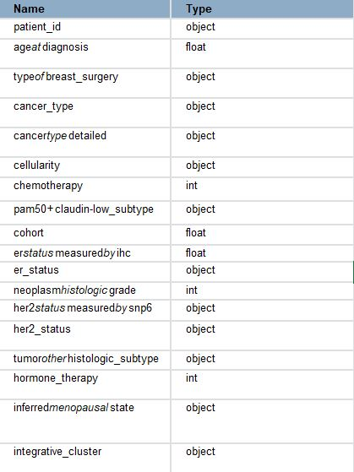
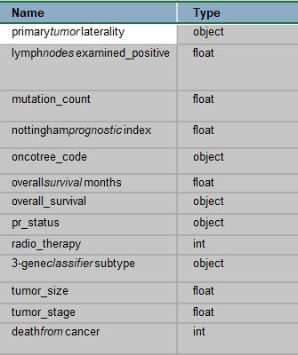
Clinical attributes in the dataset

Slide 6
Scientific Data Management life cycle
Steps of the project:
1st | Stage 1:
 | Data cleaning using openrefine
 | Stage 2:
 | T-test and visualization using R programming
 | Stage 3:
 | Create ontology using protege And queries using ‘SPARQL’.
2nd
3rd

Slide 7
OpenRefine

Slide 8
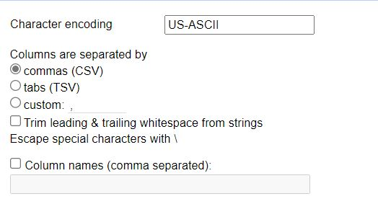
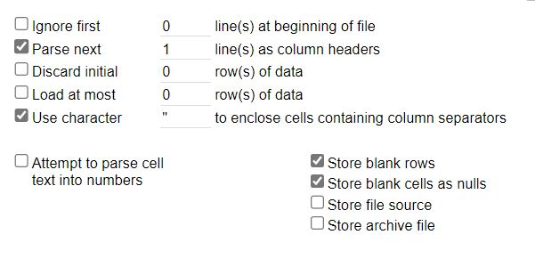
Upload dataset to openRefine
Upload and parse data .

Slide 9
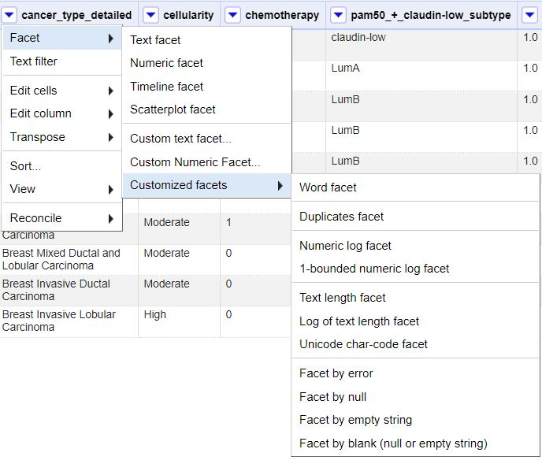
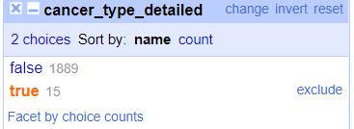
Remove empty rows
Facet by blank.

Slide 10
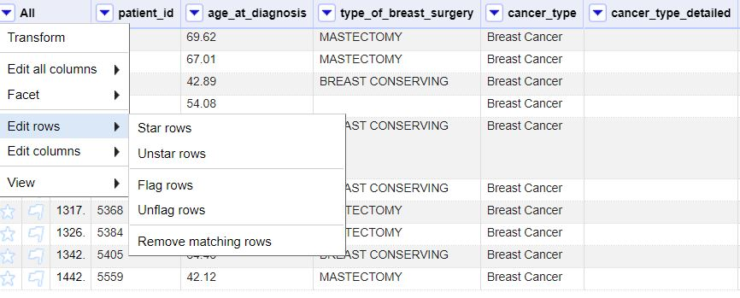
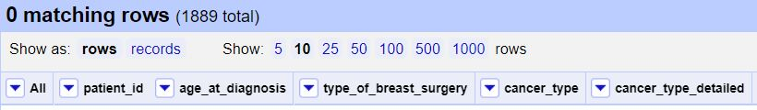
Delete matched rows.

Slide 11
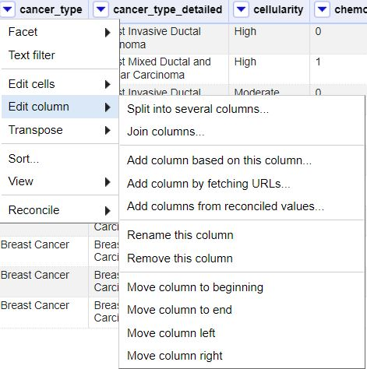
Delete columns
Delete cancer_type column because it has only one value which is breast_cancer …. Which add no value to my data.

Slide 12
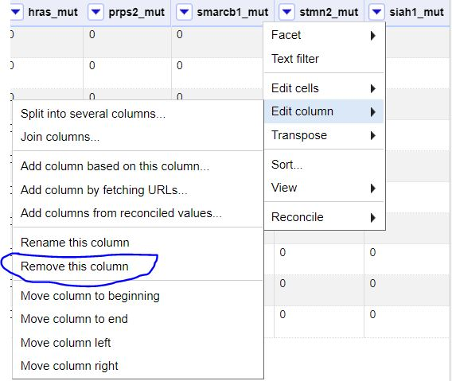
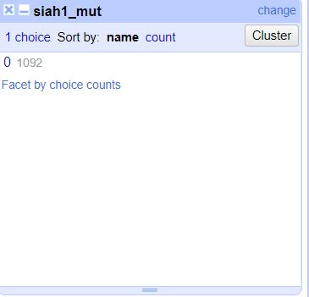
Delete columns
Remove columns that doesn’t have any mutations.

Slide 13
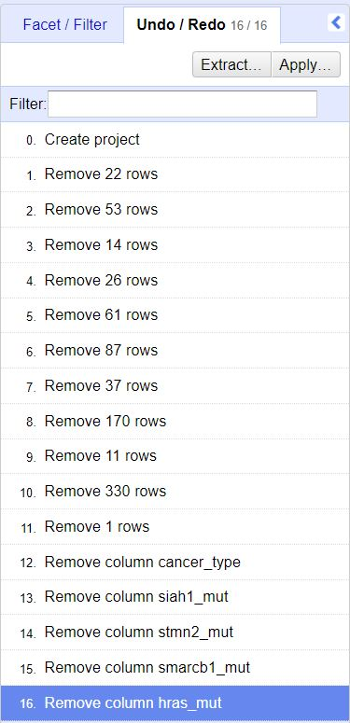
Data cleaning using OpenRefine
Deleting all rows containing “blank”values
Aka rows with empty values

Slide 14
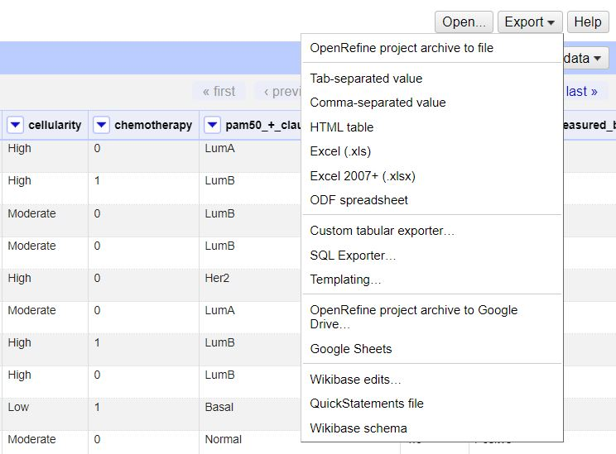
Save the clean data
Download the file as .csv formate.

Slide 15
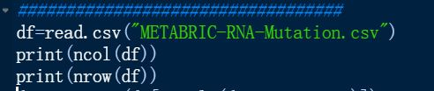
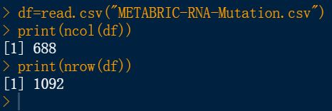
R- Programming
“Discovering data “
Read the file and check the number of rows and columns.

Slide 16

R programming (t-test&visualization)

Slide 17
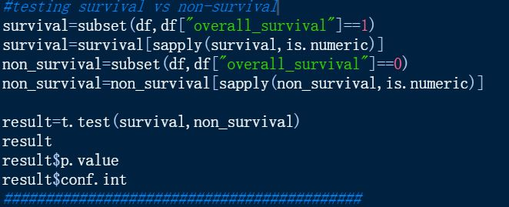
two _sample t-test
Classify our data to survival and non_survival

Slide 18
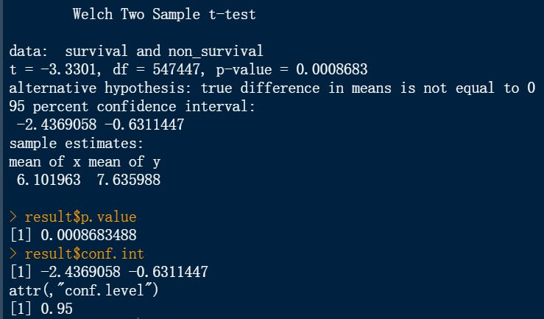
Results of 2-sample t-test
P_valuse >0.05 so ,we are 95% confidence to reject the null hypothesis.
H0:that the treatment is useless and all patients will die.
He:that the treatment is useful

Slide 19
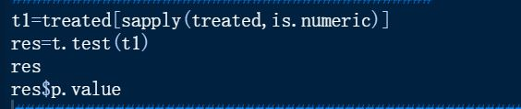
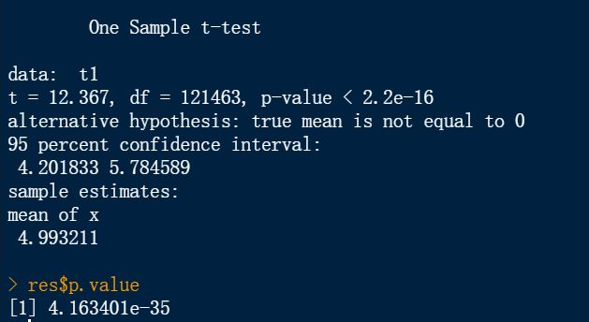
T-test
You will reject your null hypothesis in this situation as the p < 0.05. If you are comparing difference with respect to some variable in two groups, then it means both groups have significance differences in the mean values of that variable.
Notes:
§H0: The average level of chemotherapy is not effective.
§H3: The average level of chemotherapy cause effect.

Slide 20
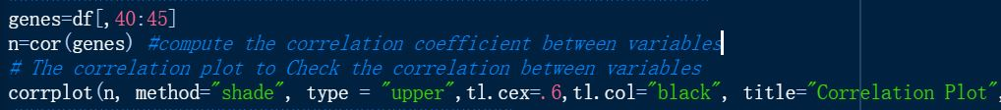
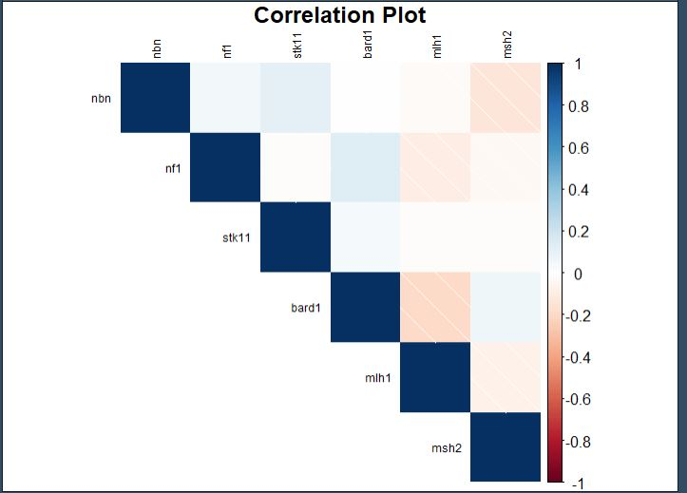
Calculate and visualize the correlation between the genes

Slide 21
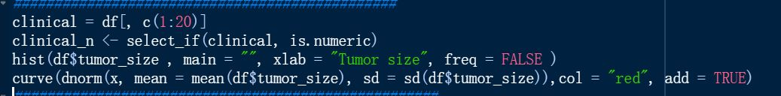
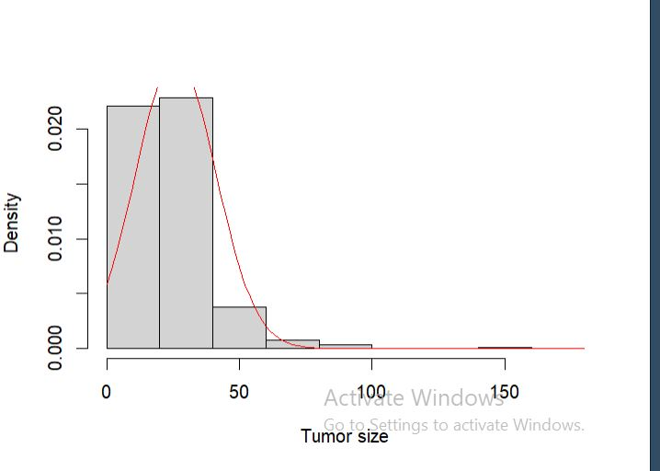
Visualize tumor size.
Find the tumor size density using histogram and curve to identify the density.
“tumor_size” and “mutation_count” variables are highly skewed and should be transformed.

Slide 22
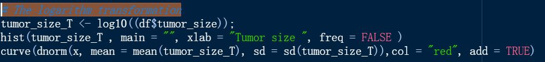
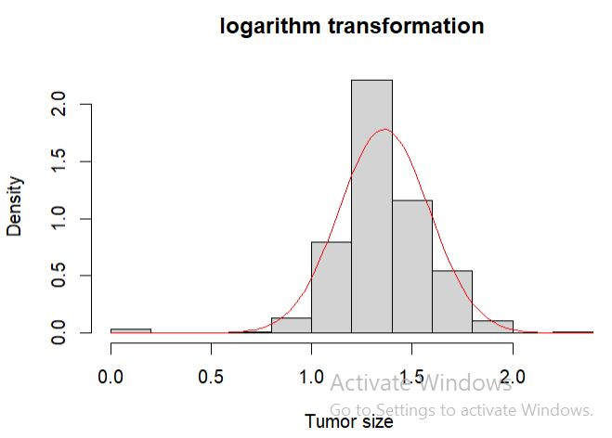
The logarithm transformation
Logarithm transformations were used to modify the data

Slide 23
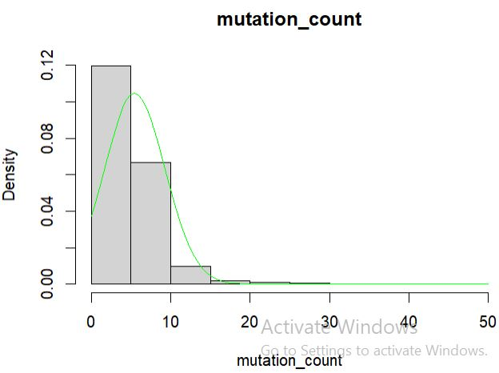
Visualize the mutation count
“tumor_size” and “mutation_count” variables are highly skewed and should be transformed.

Slide 24
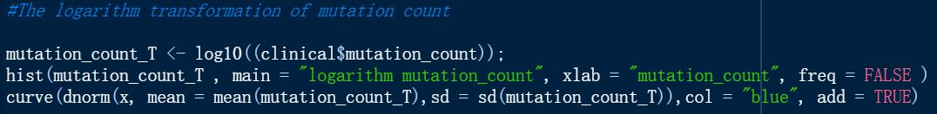
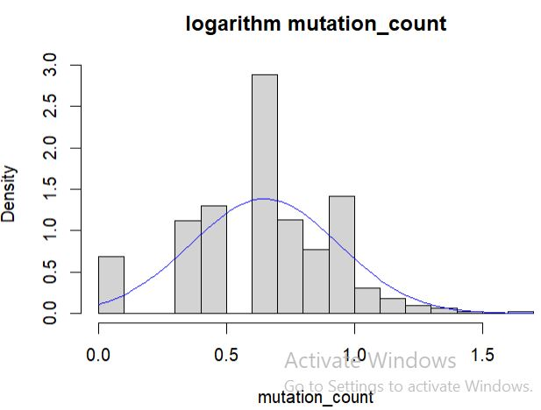
The logarithm transformation
Logarithm transformations were used to modify the data
Notes:
The distribution of numeric variables is another important parameter that should be considered. The highly skewed distribution can have a negative influence on the model results. Among all numeric variables, “tumor_size” and “mutation_count”

Slide 25
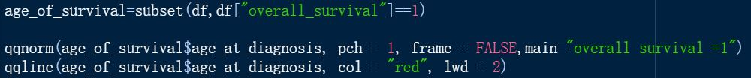
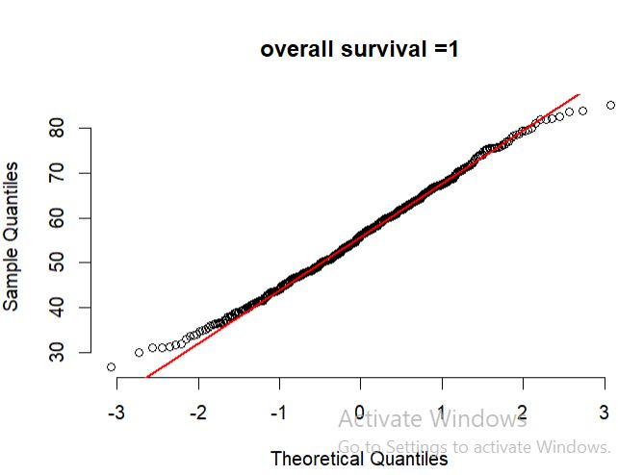
qq-plot
Q plot (or quantile-quantile plot) draws the correlation between a given sample and the normal distribution. A 45-degree reference line is also plotted. QQ plots are used to visually check the normality of the data.

Slide 26
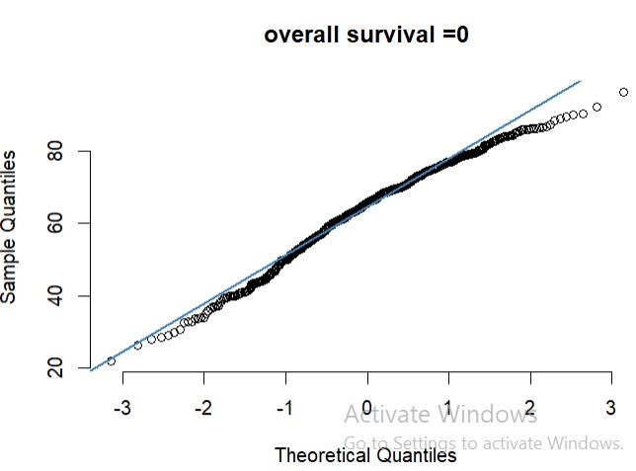
Non-survival qq-plot.

Slide 27
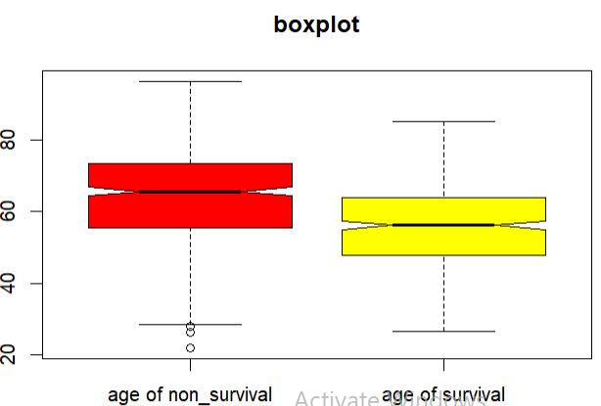
boxplots
Box plot to detect difference between samples by 5 number-summary
(survival & non-survival)

Slide 28
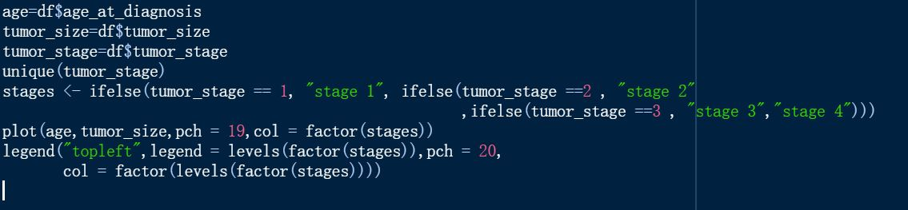
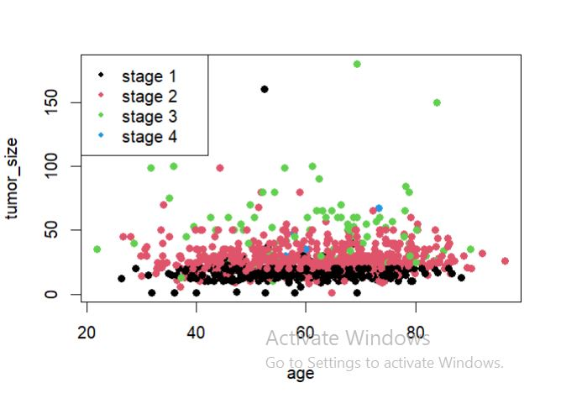
Scatter plot to identify the relation between age and the tumor sized classified by the tumor size

Slide 29
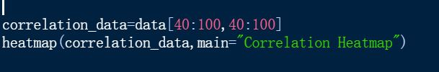
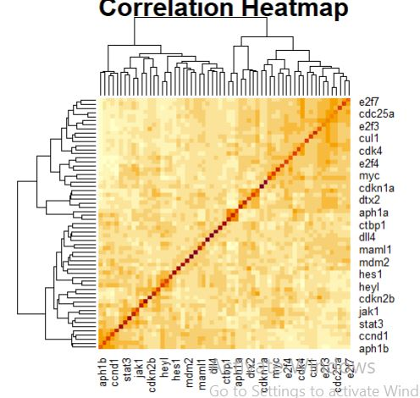
Correlation heatmap
Analyzing data usually involves a detailed analysis of each feature and how it’s correlated with each other. It’s essential to find the strength of the relationship between each feature or in other words how two variables move in association to each other.

Slide 30
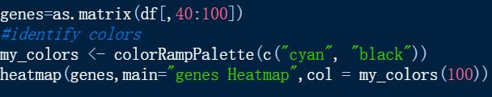
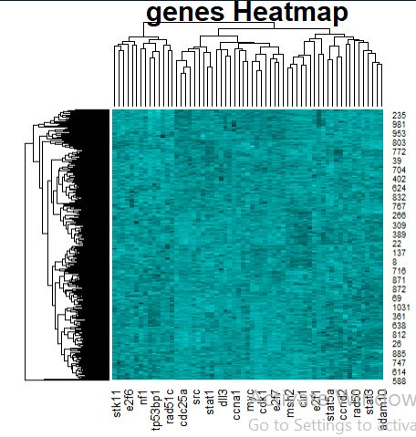
Heatmap
Heatmap to detect high or medium or low express of genes on every sample

Slide 31
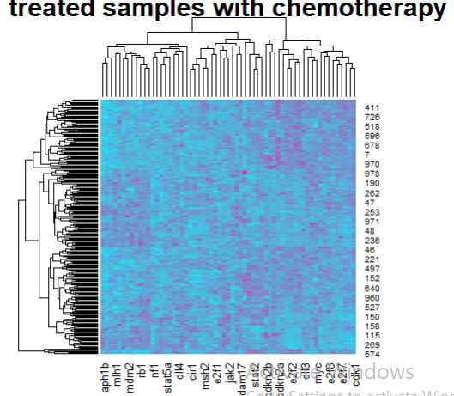
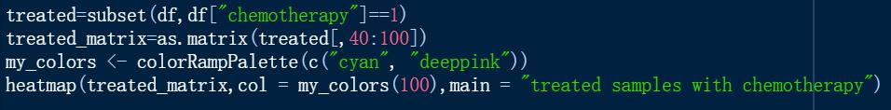
Treated sample heatmap.
Classify the data to 2 section Whether or not the patient had chemotherapy as a treatment (yes/no).then draw heatmap to detect high or medium or low express of genes on every sample .

Slide 32
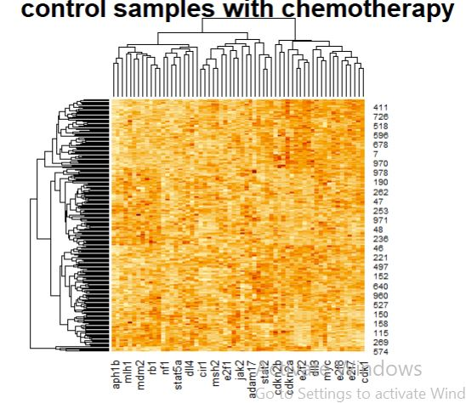
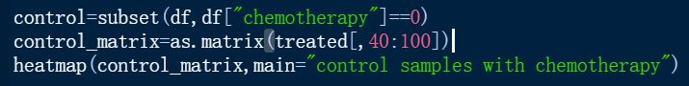
Control samples heatmap
Classify the data to 2 section Whether or not the patient had chemotherapy as a treatment (yes/no).then draw heatmap to detect high or medium or low express of genes on every sample .

Slide 33

Protege

Slide 34
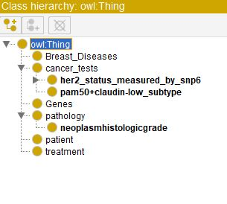
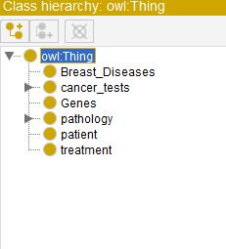
Create classes and sub-classes
super_classes
sub_classes
Notes:
E

Slide 35
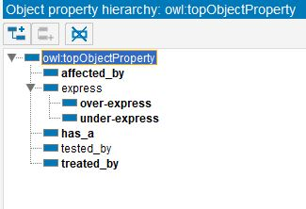
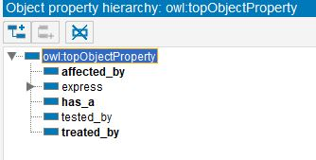
Object property

Slide 36
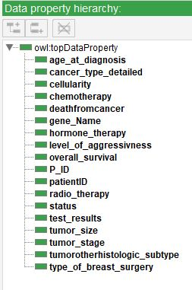
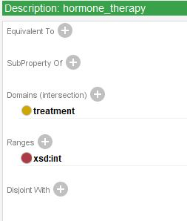
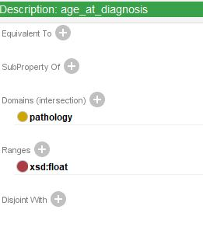
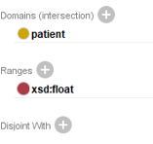
Data property

Slide 37



Data individuals

Slide 38


Property assertions

Slide 39


Property assertions

Slide 40

OntoGraf
The graph to illustrate the relation between classes

Slide 41

OntoGraf
The graph to illustrate the relation between classes

Slide 42

OntoGraf
The graph to illustrate the relation between classes

Slide 43
SPARQL

Slide 44


Slide 45


First query!
Query details: find all the patents survived from the breast cancer
results:

Slide 46

Second query!
Query details: check those who didn’t survive from breast cancer

Slide 47

Third query!
Query details: check whether the non_survival dead from cancer or other disease.

Slide 48

Forth query!
Query details :show the relations between patient and other classes.

Slide 49

Fifth query!
Query details : check the treatment details without chemotherapy.

Slide 50

Sixth query!
Query details :find over all survival of patients age_at_diagnosis >50

Slide 51

Seventh query!
Query details:find all gene names.

Slide 52

Eighth query .
Query details: select treatment where radiotherapy=1
Starting from the second result ..limit 2

Slide 53

Ninth query!
Query details :select all breast_cancer_samples tested by cancer_tests.

Slide 54

Tenth query!
Query details : select genes that over expressed in patient

Slide 55

11th query !
Query details : select genes that under-expressed in patient

Slide 56

12th query!
Query details :find all cancer tests results.

Slide 57

13th query !
Query details :select all cancer tests results =”Neutral”
Limit 2

Slide 58

14th query!
Query details : find her_status offset 2, limit 2.

Slide 59
RightField

Slide 60


Open ontology in Right Field
Upload ontology on Rightfield ..then annotate the data

Slide 61

Open the spreadsheet

Slide 62



Right field
All classes and subclasses
Cancer tests
Genes

Slide 63


Right field .
All cancer tests

Slide 64

Right field .

Slide 65
THANKS!

